Slide 1
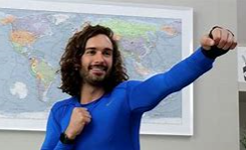
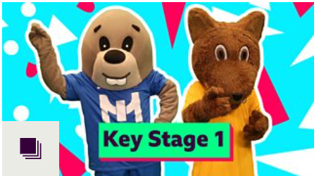
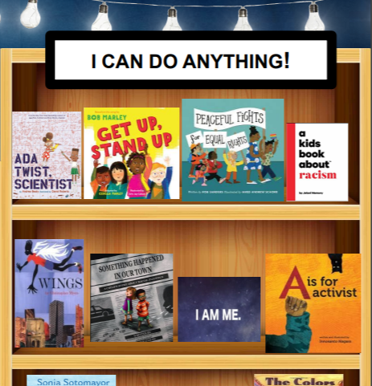
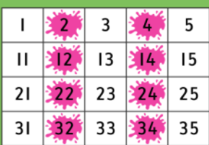
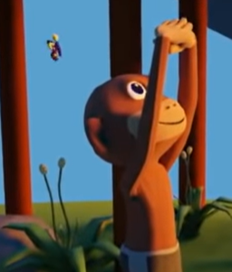
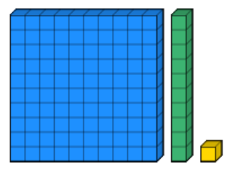
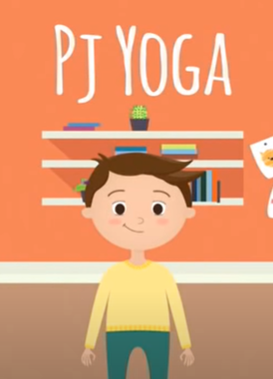
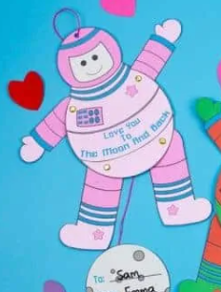
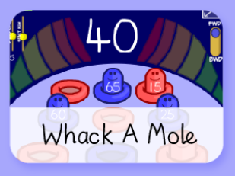
KS1 Learning Links
Don’t forget to be safe online!
These sites have been checked, but always check with an adult at home too.
5 Minute Workouts With Joe Wicks
Bedtime Stories for Kids
BBC Supermovers
Black Virtual Library
Workout 1
Workout 2
Science Bob
Number Square
Workout 3
Workout 4
Listen to a Story
Listen to some classic stories with BBC Sounds
Your adult will need to have, or register, a free account with BBC to access these stories
Workout 5
Have a go at Coding
Practice Your Typing Skills
PJ Yoga
Dienes Blocks
Calm Kids
Full Body Stretch
Hit The Button Maths Games
Phonics Play
Free Login details on first page of website.
Have Fun Making Music with Beats and Sounds
Kids Craft Room
Test Yourself With A Quiz!
Online Jigsaw Puzzles
Art for Kids Hub
ICT Games
Music Maker
Online Sketch Pad
Silly Story Maker

