Slide 1
Tuesday
Monday
Wednesday
Thursday
Friday

Slide 2
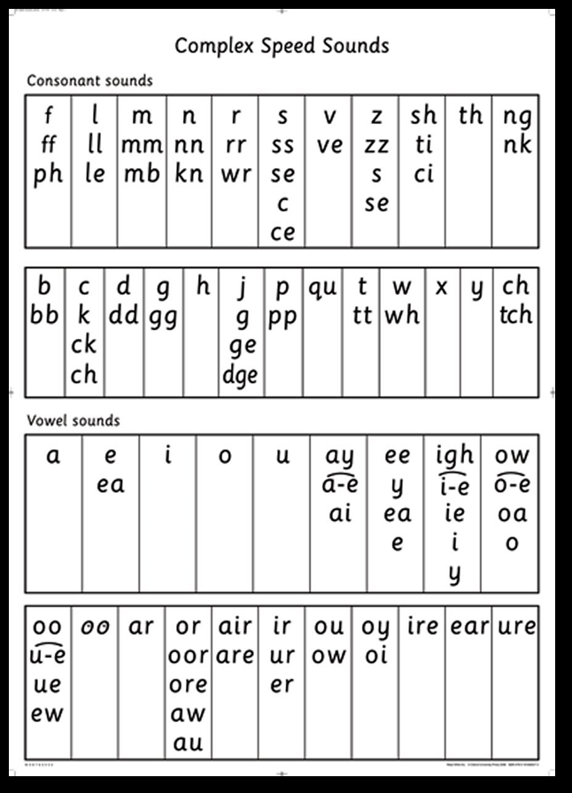
For your phonics word hunt this week, please find words with the ‘ay’ phoneme in them.
ee
Y
ea
e

Slide 3
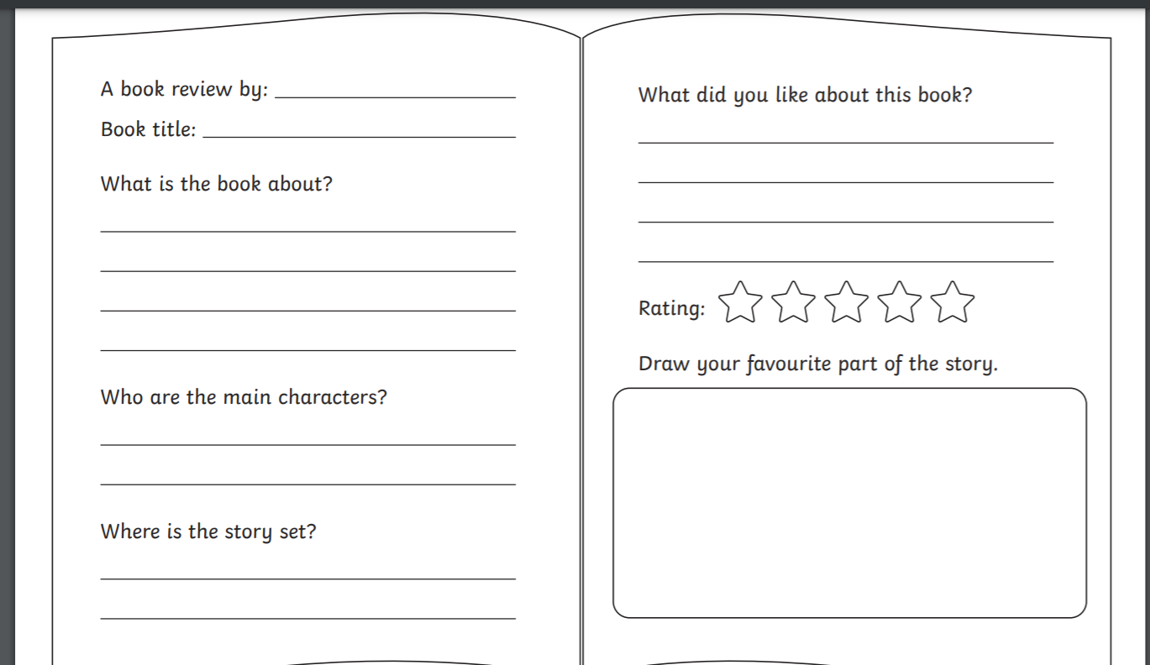
Example of a Book Review Layout

Slide 4
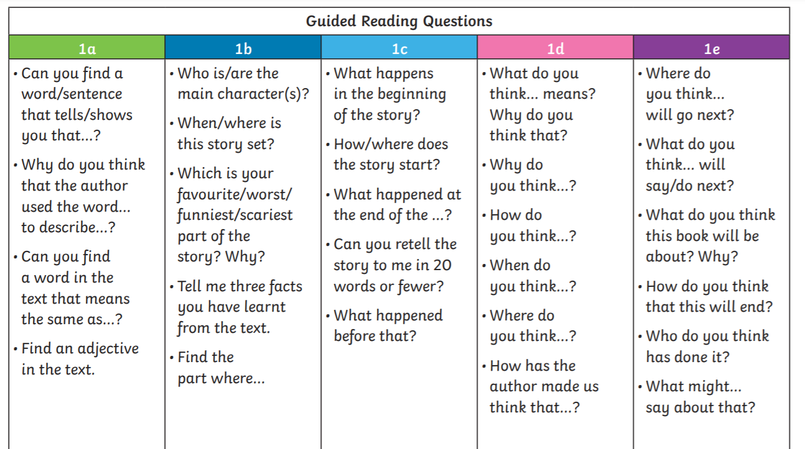
Examples of questions you could ask about the book you are reading.

Slide 5
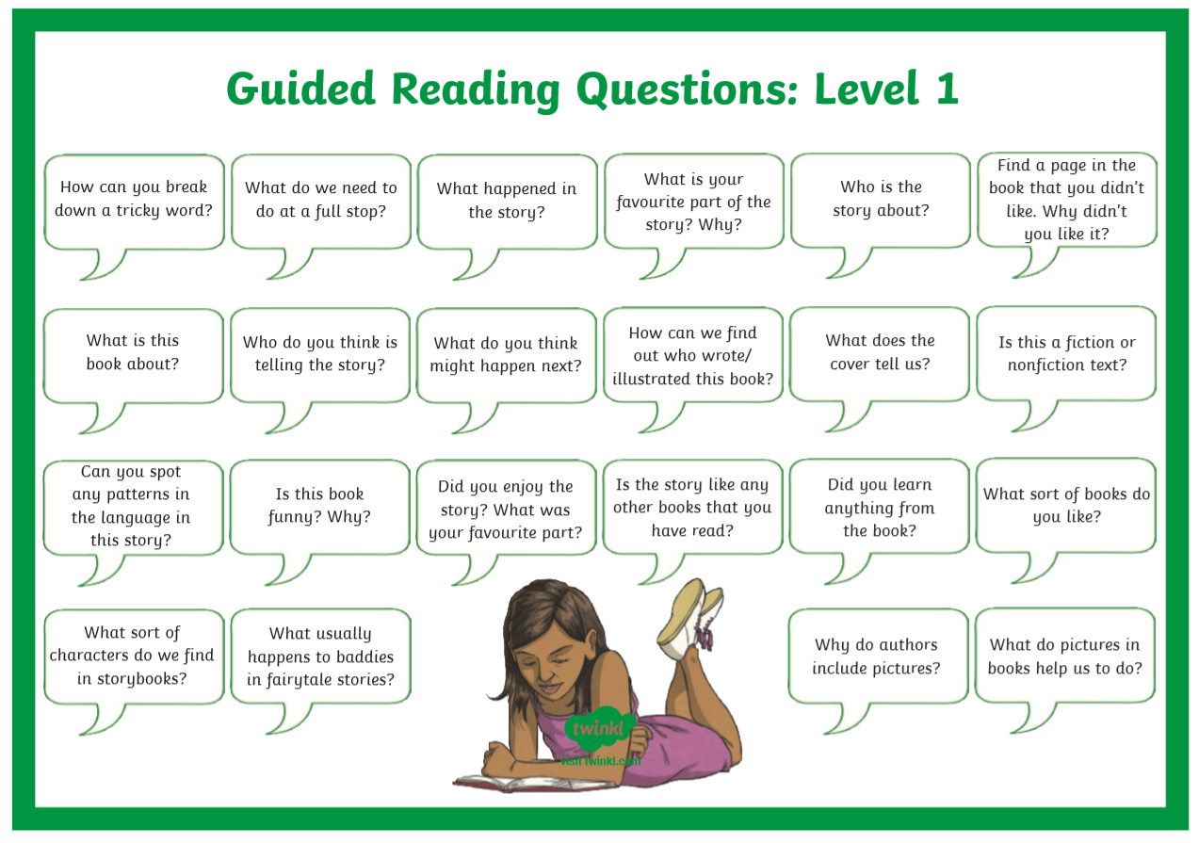
Questions your adult could ask you when you read to them.

