Slide 1
Place the fractions, decimals and percentages in descending order. a) $0.6$ $1.6$ $78\%$ $62\%$ $\frac{1}{3}$
Morning Challenge.
b)

Slide 2
L.I: To identify equivalence between fractions,
decimals and percentages
Key Words:
Fractions, decimals, percentages, equivalent, part,
whole, less than, greater than, equal to

Slide 3
Challenge:

Slide 4
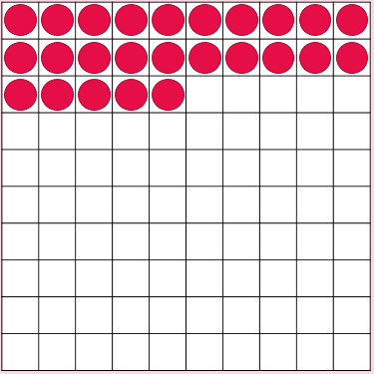
Challenge:
How can we describe this image using fractions, decimals and percentages?

Slide 5
Challenge:
Which has a larger value?
$\frac{1}{5}$ or 35%
How do you know?
Notes:
Answer: 7,030

Slide 6
Challenge:
Notes:
Answer: 15m

Slide 7
Challenge:

Slide 8
Challenge:
Notes:
Sara has 16. Dev has

Slide 9
Challenge:
Notes:
Sara has 16. Dev has

Slide 10
Plenary:
The volume of a cuboid is 64cm cubed.
The width is 4cm. What are the length and the height of the cuboid?

