Slide 1
What do you know about Lucy?
Tuesday 2nd March 2021
LI: To explore a new character and draw inferences.
SS: I can explain the effect of the author’s word choices on the reader.
SS: I can describe and draw a new character.
Notes:
What is Lucy thinking when she goes towards the wardrobe?
Why did she decide to climb inside?
How is her personality shown by the language chosen by the writer?
How do her actions reflect her personality?

Slide 2
What are our initial impressions of Mr Tumnus?
Why is it always winter in Narnia?
Describe the new setting using vivid vocabulary.
Is this a good or a bad thing?
How does the author engage with the reader’s (your) senses of sight, hearing, taste, touch, smell?
Use with Session 5

Slide 3
Purpose: To analyse the effect of word choices of the author on the reader. (A new character)
Read from ‘Lucy felt a little frightened’
From ‘He was only a little taller than Lucy herself’
From “Good evening” (Start of Chapter 2)
From “I am very pleased to meet you, Mr Tumnus”
From ‘“Meanwhile”, said Mr Tumnus’ to ‘as if they had known one another all their lives’
.

Slide 4
Using key words and inference draw a picture of Mr Tumnus Label your picture with short quotes from the text to support your drawing.

Slide 5
Key Questions
What words does the author use to describe as Lucy moves into the unknown land?
How does the author make us use our senses?
What qualities does Lucy show when she steps out of the wardrobe?
What techniques does the author use to make us want to read on?

Slide 6
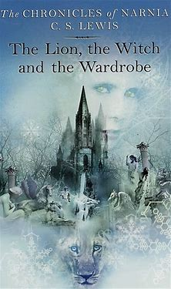
Next Step: Write a short summary of 25 words what has happened so far in the story.
Use with Session 5

Slide 7
Wednesday 3rd March 2021.
LI: To describe a setting within Narnia.
SS: I can use my senses to record descriptions.
SS: I can use expanded noun phrases to add description and emotion.

Slide 8
They had not gone far before they came to a place where the ground became rough and there were little rocks all about and little hills up and little hills down. At the bottom of one small valley Mr Tumnus turned suddenly aside as if he were going to walk straight into an unusually large rock, but at the last moment Lucy found he was leading her into the entrance of a cave. As soon as they were inside she found herself blinking in the light of a wood fire. Then Mr Tumnus stooped and took a flaming piece of wood out of the fire with a neat little pair of tings, and lit a lamp.
‘Now we shan’t be long,’ he said, and immediately put a kettle on.
Lucy thought she had never been in a nicer place. It was a little, dry, clean cave of reddish stone with a carpet on the floor and two little chairs (‘one for me and one for a friend,’ said Mr Tumnus) and a table and a dresser and a mantelpiece over the fire and above that a picture of an old Faun with a grey beard. In one corner there must be a door which Lucy thought must lead to Mr Tumnus’s bedroom, and on one wall was a shelf full of books. Lucy looked at these while he was setting out the tea things.
Use with Session 6

Slide 9
They had titles like The Life and Letters of Silenus, or Nymphs and Their Ways or Men, Monks and Gamekeepers; a Study in Popular Legend or Is Man a Myth?
‘Now, Daughter of Eve!’ said the Faun.
And it really was a wonderful tea. There was a nice brown egg, lightly boiled, for each of them, and then sardines on toast, and then buttered toast, and then toast with honey, and then sugar- topped cake. And when Lucy was tired of eating the Faun began to talk. He had wonderful tales to tell of life in the forest. He told about the midnight dances and how the Nymphs who lived in the wells and the Dryads who lived in the trees came out to dance with the Fauns; about long hunting parties after the milk-white stag who could give you wishes if you caught him; about feasting and treasure seeking with the wild Red Dwarves in deep mines and caverns far beneath the forest floor; and then about summer when the woods were green and old Silenus on his fat donkey would come and visit them, and sometimes Bacchus himself, and then the streams would run with wine instead of water and the whole forest would give itself up to jollification for weeks on end.
Use with Session 6

Slide 10
Jollification
Dryads
Mantlepiece
What do these words mean? Use a dictionary or thesaurus to check
Dresser,
Bacchus
nymphs,

Slide 11
‘Not that it isn’t always winter now,’ he added gloomily. Then to cheer himself up he took out from its case on the dresser a strange little flute that looked as if it were made of straw and began to play. And the tune he played made Lucy want to cry and laugh and dance and go to sleep all at the same time. It must have been hours later when she shook herself and said:
‘Oh Mr Tumnus – I’m so sorry to stop you, and I do love that tune – but really, I must go home. I only meant to stay for a few minutes.’
Use with Session 6

Slide 12
What can you see?
What can you hear?
What can you smell?
What do you think and feel?
Use with Session 6

Slide 13
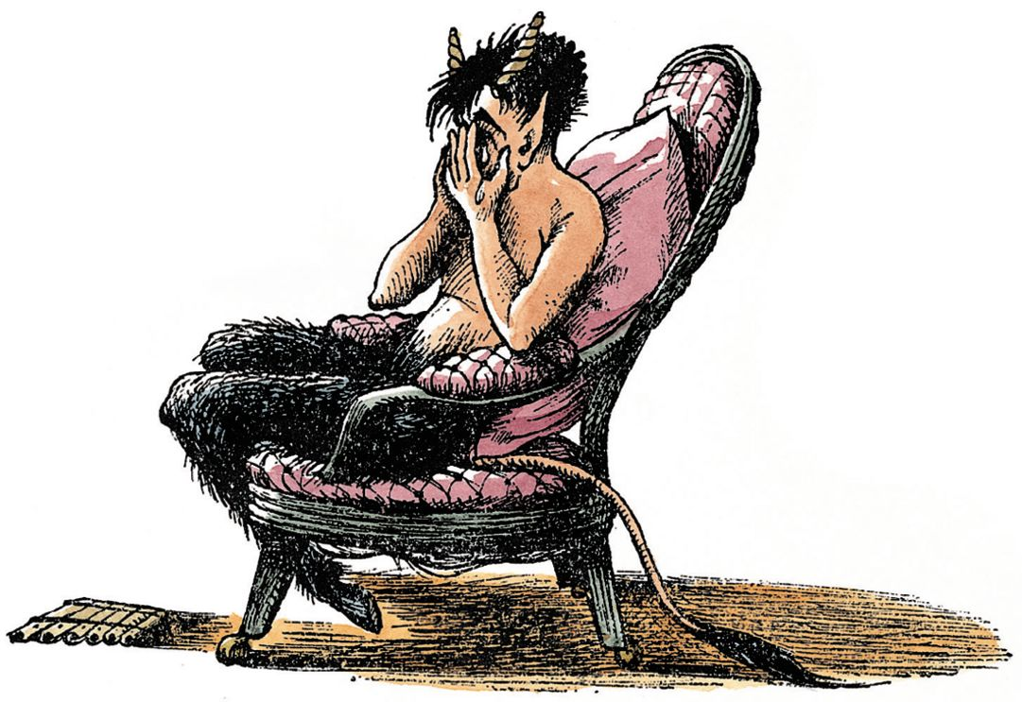
Plenary
‘It’s no good now you know’ said
the Faun, laying down its flute and shaking its head at her very sorrowfully.
Why do you think the mood has changed so suddenly?
What does Mr Tumnus mean by this?
What might happen next?
Use with Session 7

